Slide 1
RECIPE FINDER WEB PAGE By Inderesh . S

Slide 2
AGENDA :
Abstract
Advantages
Disadvantages
Hardware Requirements
Software Requirements
Modules
Conclusion

Slide 3
ABSTRACT:
This abstract describes the development of a recipe finder web page using HTML, CSS, and JavaScript. The application allows users to search for and view recipes by providing a list of available ingredients. The core purpose is to provide a user-friendly and efficient tool for home cooks to discover new meal ideas, make use of existing pantry items, and reduce food waste.

Slide 4
ADVANTAGES:
Faster loading times: JavaScript allows a recipe finder to process user requests on the client's side (in the browser), which reduces the number of interactions with a server
Reduced server load: By handling a lot of the logic and processing directly in the user's browser, client-side scripting with JavaScript decreases the workload on the server

Slide 5
DISADVANTAGES
Data updates are difficult: To add, remove, or change recipes, a developer must manually update the JavaScript or JSON file containing the recipe data and then redeploy the entire website.
No Persistent Storage: User-generated content, such as favorited recipes or personalized notes, cannot be saved between sessions or across different devices, as there is no database to store this information.

Slide 6
HARDWARE REQUIREMENTS:
Processor (CPU): A multi-core processor (4+ cores) to handle a larger number of simultaneous requests.
Memory (RAM): 16+ GB of RAM, especially if the database is running on the same machine.
Storage: A Solid-State Drive (SSD) of 100 GB or more for quick database access and to store images and other media.
Network: A dedicated connection with high bandwidth and low latency is critical to ensure a fast experience for many users.

Slide 7
SOFTWARE REQUIREMENTS:
Fetch recipe data: The application must fetch recipe data from a public, third-party API using JavaScript.
Handle API responses: The JavaScript code must parse the JSON data returned by the API and use it to dynamically generate and update the web page's content.

Slide 8
MODULES:
Search Module
Files involved: food.html, recipe.js Purpose: Allows users to search for recipes by entering a dish name. Key elements:
#user-input — input field for the dish name
#search-btn — button to trigger the search
JS function searchMeal() fetches data from the TheMealDB API

Slide 9
Recipe Display Module
Files: recipe.js, styles.css Purpose: Displays recipe image, name, area, ingredients, and preparation steps. UI components:
Image of the meal
.details div → name & region
.ingredient-content → ingredients list
.recipe section → full recipe instructions

Slide 10
UI & Styling Module
File: styles.css Purpose: Handles layout, colours ,fonts, and responsiveness. Highlights:
Modern responsive design using CSS Grid
Separate sections for input, results, and footer

Slide 11
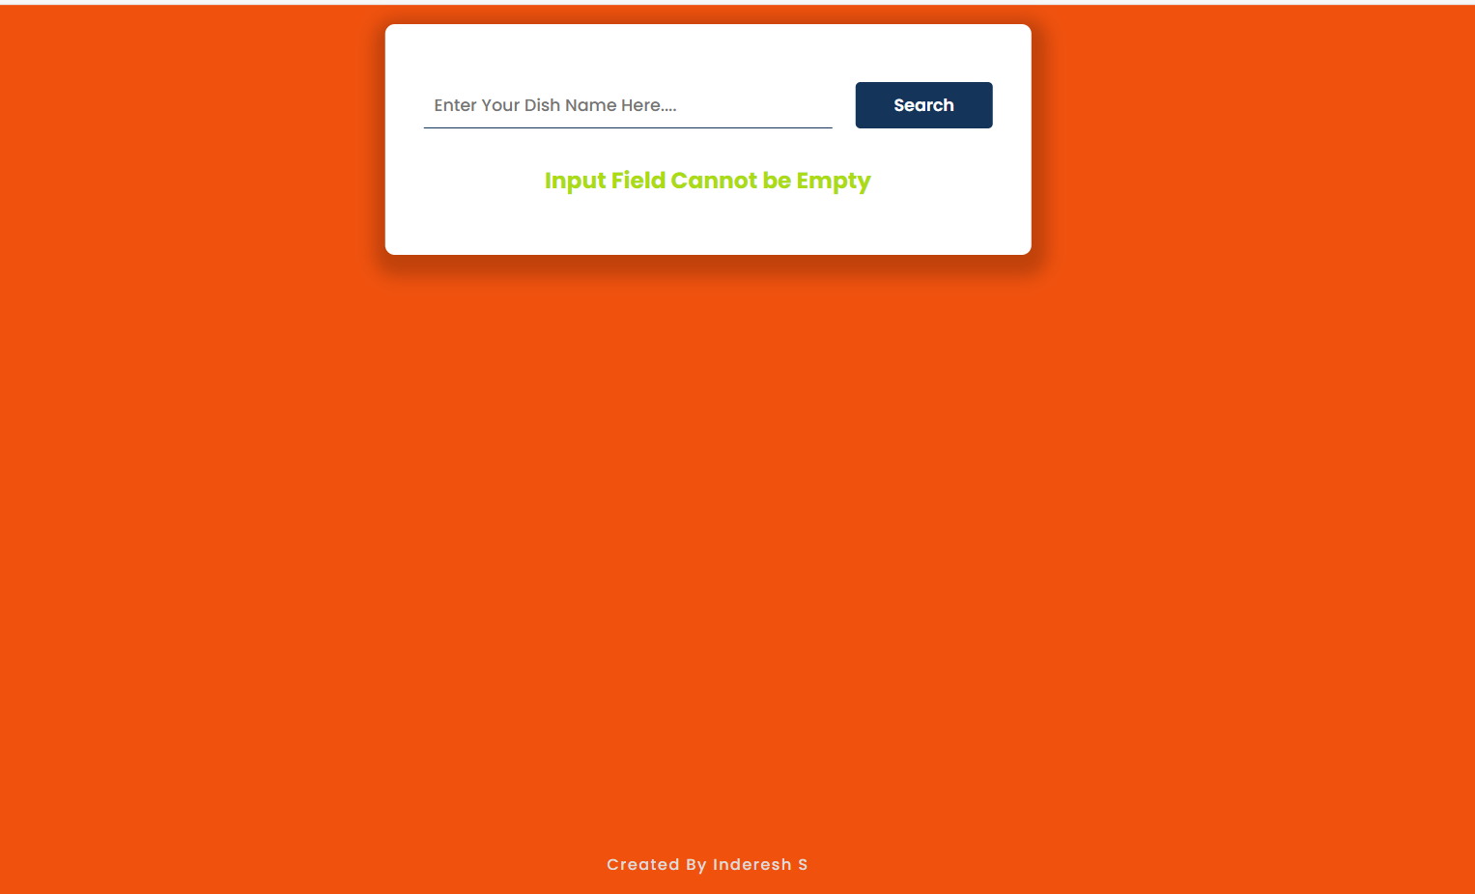
SAMPLE OUTPUT:

Slide 12
CONCLUSION:
Using HTML, CSS, and JavaScript for a recipe finder web page allows for a dynamic and user-friendly experience by creating a solid structure, appealing visual design, and interactive functionality. The conclusion of such a project highlights the successful integration of these core front-end technologies to deliver a practical and engaging application.

